Slide 1
Marriage Tune-Up (1)
Expectations and Empty Love Tanks

Slide 2
Introduction
Ideas have Consequences.

Slide 3
I. Two Competing Ideologies.
A God-Centered View.
A Human-Centered View.

Slide 4
Psalm 8
“¹O LORD, our Lord, how majestic is your name in all the earth! You have set your glory above the heavens. ²Out of the mouth of babes and infants, you have established strength because of your foes, to still the enemy and the avenger.
“ ³When I look at your heavens, the work of your fingers, the moon and the stars, which you have set in place, ⁴ what is man that you are mindful of him, and the son of man that you care for him? ⁵Yet you have made him a little lower than the heavenly beings and crowned him with glory and honor. ⁶You have given him dominion over the works of your hands; you have put all things under his feet, ⁷all sheep and oxen, and also the beasts of the field, ⁸the birds of the heavens, and the fish of the sea, whatever passes along the paths of the seas. ⁹O LORD, our Lord, how majestic is your name in all the earth!”

Slide 5
I. Two Competing Ideologies.
A God-Centered View
God is incomparably great
He has highly blessed humanity with great privilege
Humans only have worth in relation to God
A Human-Centered View
Humans were always special
“God” was a only a useful invention—now obsolete
The autonomous self is the only god we know or need

Slide 6
II. The Incursion of Humanistic Psychology.
Four tenets of humanistic selfism
People are completely good at the heart
All that is negative and evil is external
One’s highest “duty” is to discover and celebrate the self
Restraints, rules, and religion are bad—they inhibit self-discovery and self-expression

Slide 7
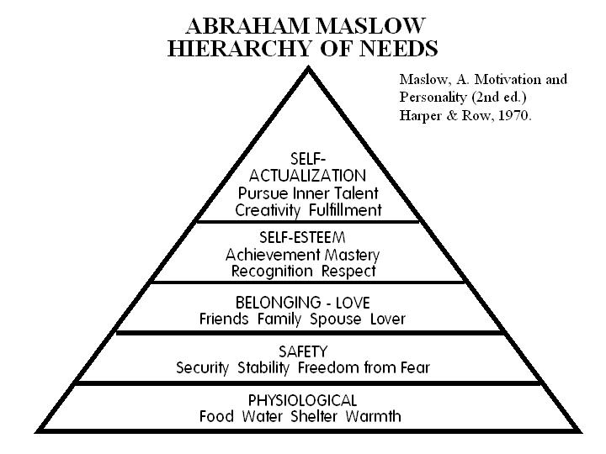

Slide 8
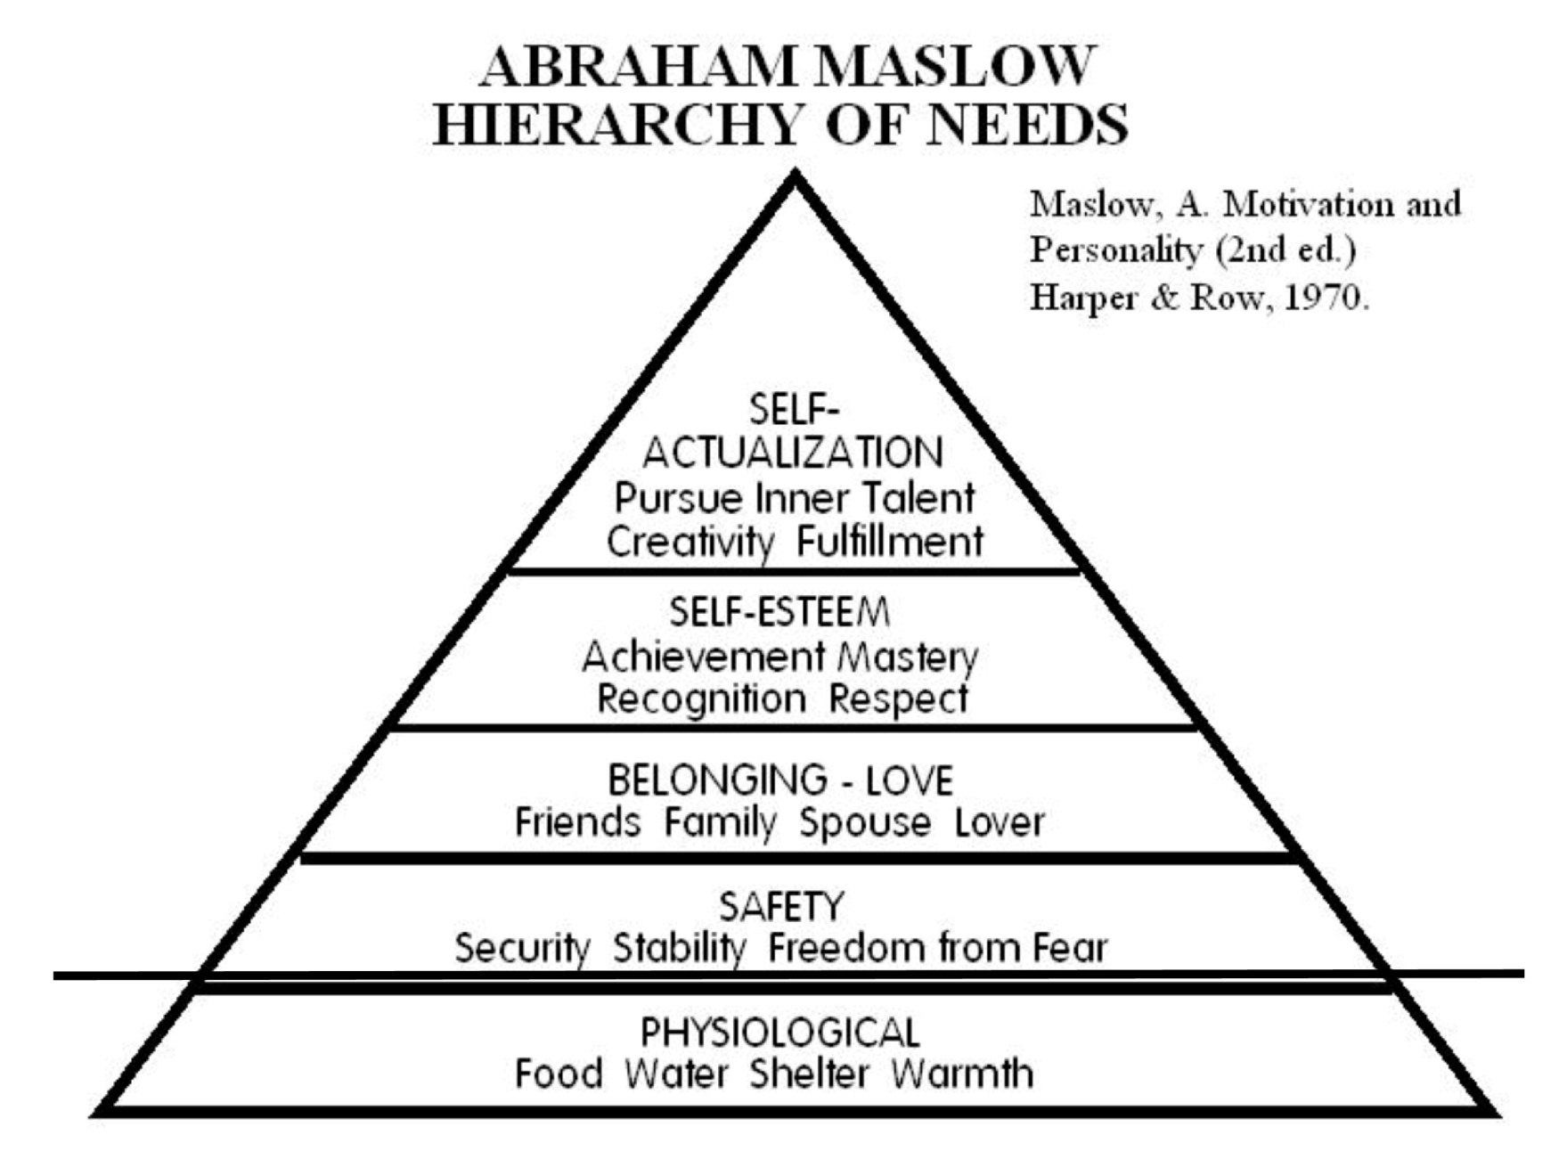

Slide 9
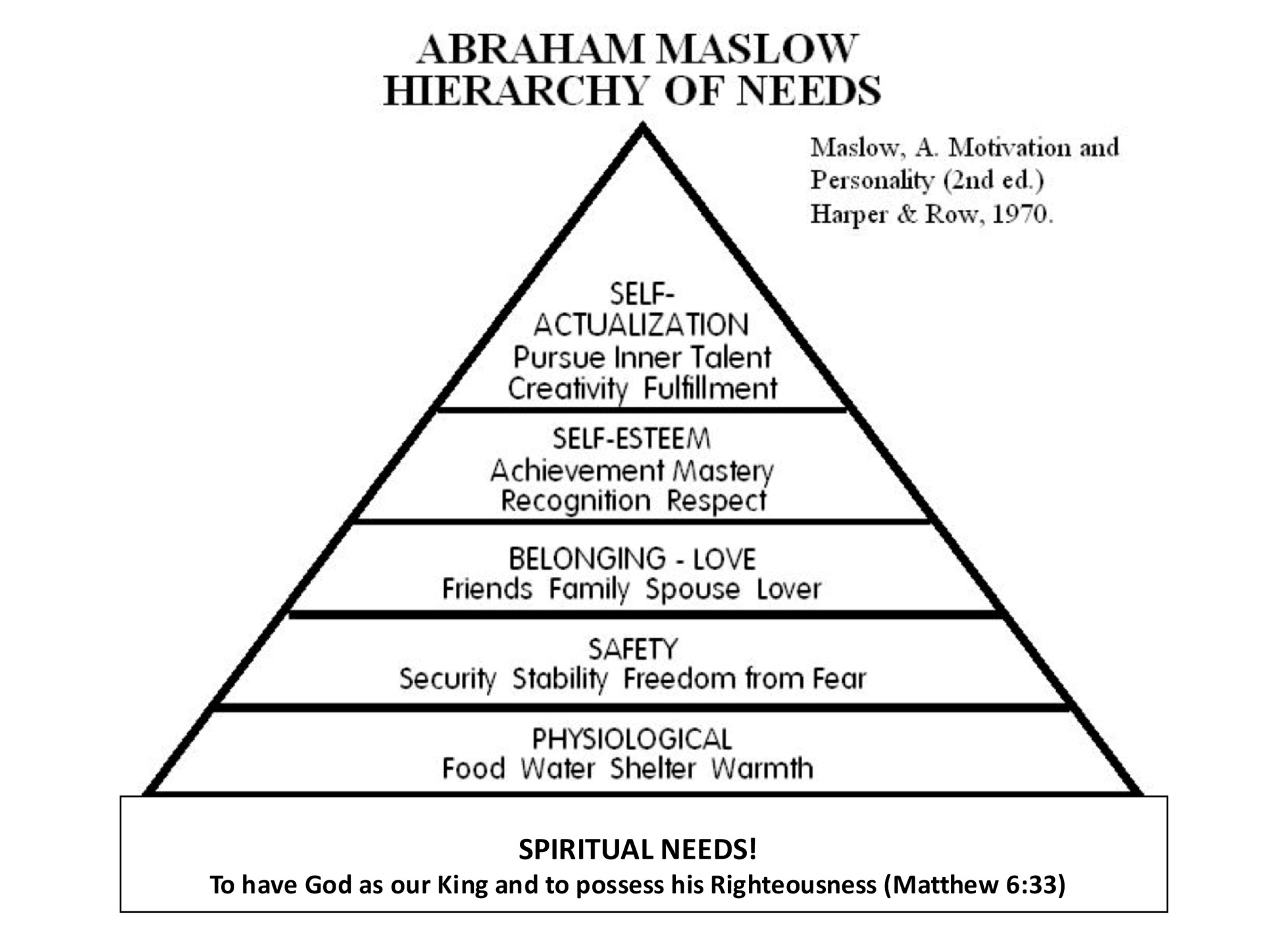

Slide 11
III. Do People have Emotional Needs?
Humanistic psychology assumes that most of our needs are psychological/emotional.
Do people have emotional “needs”?
The Bible speaks of physical needs (food, water, etc.)
The Bible has much to say about our spiritual needs
What Biblical support is there for “emotional” needs?
Body, Soul, Spirit?
Created in God’s image—God’s “longings”?
People have many “desires,” some good, some bad.

Slide 12
IV. Humanistic Psychology in the Church.
Philosophical humanism trumped God with the self
Humanistic psychology invaded our culture
Humanistic psychology has worked into the church.
Two example:
The Five Love Languages by Gary Chapman
Love and Respect by Emerson Eggerichs

Slide 14
IV. Humanistic Psychology in the Church.
Gary Chapman, The Five Love Languages
Over 4,000,000 sold, translated into 36 languages
Summary:
People show love in different ways
If you show love in the way others want, they will tend to love you back
We all have “love tanks” that need filling
Bad things happen when our love tank is empty ☹
Good things happen when our love tanks are full ☺

Slide 15
IV. Humanistic Psychology in the Church.
Critique of The Five Love Languages by David Powlison in Seeing with New Eyes

Slide 17
IV. Humanistic Psychology in the Church.
Critique of The Five Love Languages by David Powlison in Seeing with New Eyes
Sounds a lot like “You scratch my back, I’ll scratch yours.”
Matthew 5:46-47

Slide 18
Matthew 5:46-47
“⁴⁶For if you love those who love you, what reward do you have? Do not even the tax collectors do the same? ⁴⁷And if you greet only your brothers, what more are you doing than others? Do not even the Gentiles do the same?”

Slide 19
IV. Humanistic Psychology in the Church.
Critique of The Five Love Languages by David Powlison in Seeing with New Eyes
Sounds a lot like “You scratch my back, I’ll scratch yours.”
Matthew 5:46-47
This is not dictinctively Christian and does not go far enough

Slide 20
David Powlison on 5LL
“This is the instinct that he appeals to in his readers. If I scratch your back, you’ll tend to scratch mine. If you’re happy to see me, I’ll tend to be happy to see you, too. So 5LL teaches you to be aware of what others want, and then tells you to give that to them. This is the principle behind How to Win Friends and Influence People and The 30-Second Manager. It’s the dynamic at work in hundreds of other books on ‘relational skills,’ or ‘attending skills,’ or ‘salesmanship,’ or ‘how to find the love you want.’ Identify the felt need and meet it, and, odds are, your relationships will go pretty well.” (p. 228)

Slide 21
David Powlison on 5LL
“If your spouse or parent or friends loved you better, would your problems be fundamentally solved? Does having an empty love tank cause you to mistreat others? Do you return evil for evil because evil is done to you? If love tanks could only get filled all around, if others could just speak your language and if you could just speak theirs, could that really produce the kingdom of perfect relationships? If you could only give others enough of the right thing, would they love you in return? Is the principle that ‘Gentiles love those who love them’ really the key principle for producing marital success and happiness? The answer to each question in this paragraph is a profound No.” (p. 230)

Slide 22
David Powlison on 5LL
“The 5LL model fails Human Nature 101….(I)t doesn’t really understand human psychology. That basic misunderstanding has systematic misleading effects. Fallenness brings not only ignorance about how best to love others, it brings perverse unwillingness and inability to love. It ingrains the perception that our lusts are in fact needs, empty places inside where others have disappointed us. The empty emotional tank construct is congenial to our fallen instincts, not transformative. It leaves what we instinctively want as an unquestionable good that must be fulfilled. It not only leaves fundamental self-interest unchallenged, it plays to self interest.” (p. 230)

Slide 23
IV. Humanistic Psychology in the Church.
Love and Respect by Emerson Eggerichs
Subtitled: The Love She Most Desires, the Respect he Desperately Needs

Slide 25
IV. Humanistic Psychology in the Church.
Love and Respect by Emerson Eggerichs
Summary:
Ephesians 5:33 commands husbands to love their wives and wives to respect their husbands
This proves that wives need love and husbands need respect
When either does not receive what they need it causes “the crazy cycle”

Slide 26
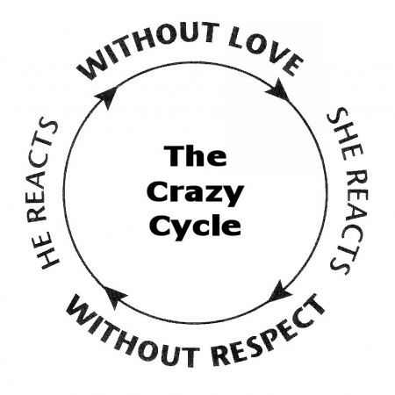

Slide 27
IV. Humanistic Psychology in the Church.
Examining the logic of Love and Respect
Major: The purpose of marriage is to meet my needs for fulfillment and satisfaction.
Minor: God commands that husbands love their wives and wives respect their husbands.
Therefore: Wives must need love and husbands must need respect for true satisfaction
What’s the logical fallacy in this reasoning?

Slide 28
IV. Humanistic Psychology in the Church.
Rather…
Major: The purpose of marriage is to glorify God in my sanctification.
Minor: God commands that husbands love their wives and wives respect their husbands.
Therefore: Husbands must need to love their wives and wives must need to respect their husbands in order to glorify God in their sanctification.
Eggerichs turns an obligation into
a self-centered expectation, even need.

Slide 29
V. Where Quarrels Come From.
Marital discord comes from our desires (James 4:1-3)
“1 What causes quarrels and what causes fights among you? Is it not this, that your passions are at war within you? 2 You desire and do not have, so you murder. You covet and cannot obtain, so you fight and quarrel. You do not have, because you do not ask. 3 You ask and do not receive, because you ask wrongly, to spend it on your passions.”

Slide 30
V. Where Quarrels Come From.
RESPONSE→ REACTION
ASSUMPTIONS→ ATTITUDE
EXPECTATIONS→ ENTITLEMENT
DESIRES→ DEMANDS
/SURRENDERED TO CHRIST
HEART--
\SURRENDERED TO SELF

Slide 31
V. Where Quarrels Come From.
Reaction → “punish”
Response → “blame”
Attitude → “must be”
Assumptions → “will be”
Entitlement → “deserve”
Expectations → “should”
Demands → “need”
Desires → “want”

Slide 32
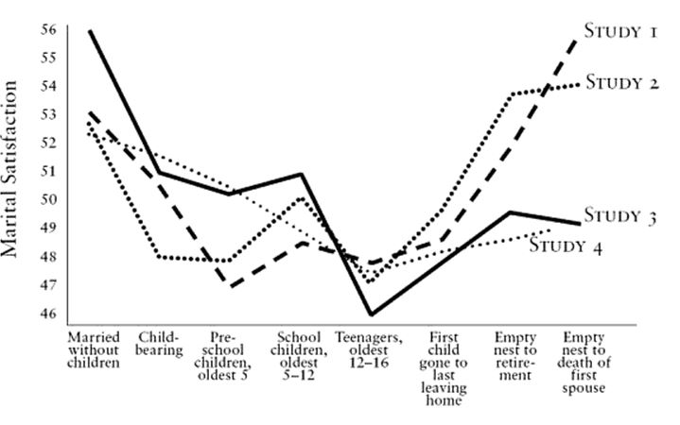
Quiz: What’s wrong with this picture?

Slide 33
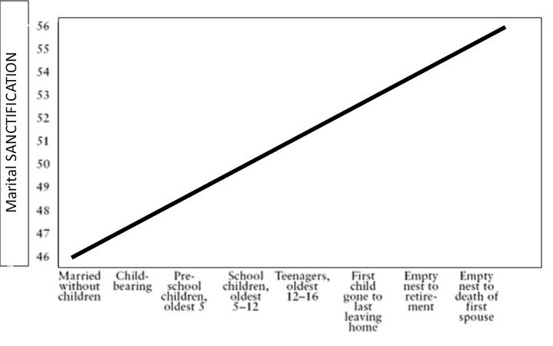
A Better Question to Focus on—Sanctification!

Slide 34
IV. Male and Female/Masculine and Feminine
What is a “masculine” husband and a “feminine” wife?
Husbands desire to penetrate
Wives desire to be penetrate

Slide 35
Ephesians 5:22-33
“²² Wives, submit to your own husbands, as to the Lord. ²³For the husband is the head of the wife even as Christ is the head of the church, his body, and is himself its Savior. 24 Now as the church submits to Christ, so also wives should submit in everything to their husbands.
²⁵ Husbands, love your wives, as Christ loved the church and gave himself up for her, ²⁶that he might sanctify her, having cleansed her by the washing of water with the word, ²⁷so that he might present the church to himself in splendor, without spot or wrinkle or any such thing, that she might be holy and without blemish. ²⁸In the same way husbands should love their wives as their own bodies. He who loves his wife loves himself. ²⁹For no one ever hated his own flesh, but nourishes and cherishes it, just as Christ does the church, ³⁰because we are members of his body. ³¹“Therefore a man shall leave his father and mother and hold fast to his wife, and the two shall become one flesh.” ³²This mystery is profound, and I am saying that it refers to Christ and the church. ³³However, let each one of you love his wife as himself, and let the
wife see that she respects her husband.”

Slide 36
IV. Male and Female/Masculine and Feminine
What is a “masculine” husband and a “feminine” wife?
Husbands desire to penetrate
Wives desire to be penetrate
Paul draws an analogy between husband and wife and Christ and his bride, the church
Christ infuses his church with the Spirit of Life
The church blossoms into beauty/holiness and frutifulness

Slide 37
IV. Male and Female/Masculine and Feminine
A Christian husband penetrates bringing good things
Progenitor
Provider
Protector
A Christian wife receives and responds
Fruitfulness
Felicity
Flourishing

Slide 38
Proverbs 31:28-31
“²⁸Her children rise up and call her blessed; her husband also, and he praises her: ²⁹“Many women have done excellently, but you surpass them all.” ³⁰Charm is deceitful, and beauty is vain, but a woman who fears the LORD is to be praised. ³¹Give her of the fruit of her hands, and let her works praise her in the gates.”

Slide 39
FUTURE SUMMER SEMINARS FOR 2016
August 16 “Marriage Tune-Up (2): Sexual Pleasure in Marriage”
(All seminars are at the church and begin at 7:00 p.m.)

